Slide 1

Department of Information Technology
A.P. Shah Institute of Technology
G.B.Road,Kasarvadavli, Thane(W), Mumbai-400615
UNIVERSITY OF MUMBAI
Academic Year 2020-2021

Slide 2
A Project Report on
Krishi Setu: Connecting Farmers and Consumers
Submitted in partial fulfillment of the degree of
Bachelor of Engineering(Sem-8)
in
INFORMATION TECHNOLOGY
By
Shreyas Chorge(17104022)
Vedangi Naigaonkar(16104046)
Abhijit Ambre(17104030)
Under the Guidance of
Prof.Anagha Aher Prof.Neha Deshmukh

Slide 3
1.Project Conception and Initiation

Slide 4
1.1 Abstract
Distributed messaging structures are the core for Modern applications build with micro services architecture. Messaging technologies are every increasing need for modern applications which have to deal with a heavy traffic. These technologies are crucial for micro services, cloud native applications and data streaming applications. With ever increasing traffic scalability of the application is important factor. It must be done in such a way that it is provides all the necessary services to its users and should not cost more than necessary while maintaining security and the integrity of the users using the application. Krishi Setu is an application that is build on the idea of loosely coupled micro services.

Slide 5
1.2 Objectives
To build a distributed computing network with kubernetes
To set up scalable image upload
To set up Payments
To let farmers to sell products
To let consumers to buy products

Slide 6
1.3 Literature Review
1 | Title : | Kubernetes as an Availability Manager for Micro service Applications
 | Author and Publisher : | Leila Abdollahi Vayghan, Mohamed Aymen Saied, Maria Toeroe, Ferhat Khendek, unpublished.
 | Methodology : | The authors have presented a brief overview of Kubernetes architectural components and architectures for deploying microservices based application with Kubernetes. The authors have investigated the impact of adding redundancy on the availability of micro service-based applications and performed experiments under Kubernetes default configuration and its most responsive one.

Slide 7
1.3 Literature Review
2 | Title: | Modern Messaging for Distributed Systems
 | Author and Publisher: | L Magnoni, Journal of Physics Conference Series 608(1):012038
 | Methodology : | L Magnoni has discussed the Importance of loosely coupled communication, Connection-oriented communication, Messaging for loosely coupled communication, Messaging scenario, Messaging middleware.

Slide 8
1.3 Literature Review
3 | Title: | Modern Messaging Queues - RabbitMQ, NATS and NATS Streaming
 | Author and Publisher: | Pooja J Bhat, Priya D, International Journal of Recent Technology and Engineering (IJRTE)
 | Description: | Authors have explained in detail about the Messaging Technologies and Terminologies. Authors have also compared and explained the features of these technologies and provided the benchmark for RabbitMQ and NATS. They have also explained the architecture of RabbitMQ and NATS.

Slide 9
1.4 Problem Definition
Farmers these days do not get proper value for the farm produce. They strive so hard yet are compelled to sell their produce at a low price. The middleman forces the farmer to sell his produce at a low rate.

Slide 10
1.5 Scope
To make a distributed computing platform for farmers to sell their products and for consumers to buy the products.

Slide 11
1.6 Technology stack
NodeJs
ReactJs
MongoDB
ExpressJs
Docker
Kubernetes

Slide 12
1.7 Benefits for environment & Society
Farmers would be getting their appropriate value for their goods
The entire application is leveraging Open Source technologies. And the application is Open Source thus encouraging the developers community to contribute to the growth of the application and making it more reliable to its users

Slide 13
2. Project Design

Slide 14
2.1 Proposed System
We can create the platform for farmers where they can directly sell their good in quantity they desire to either direct consumers or the local distributors in major cities, thus severing the chain of middlemen

Slide 15
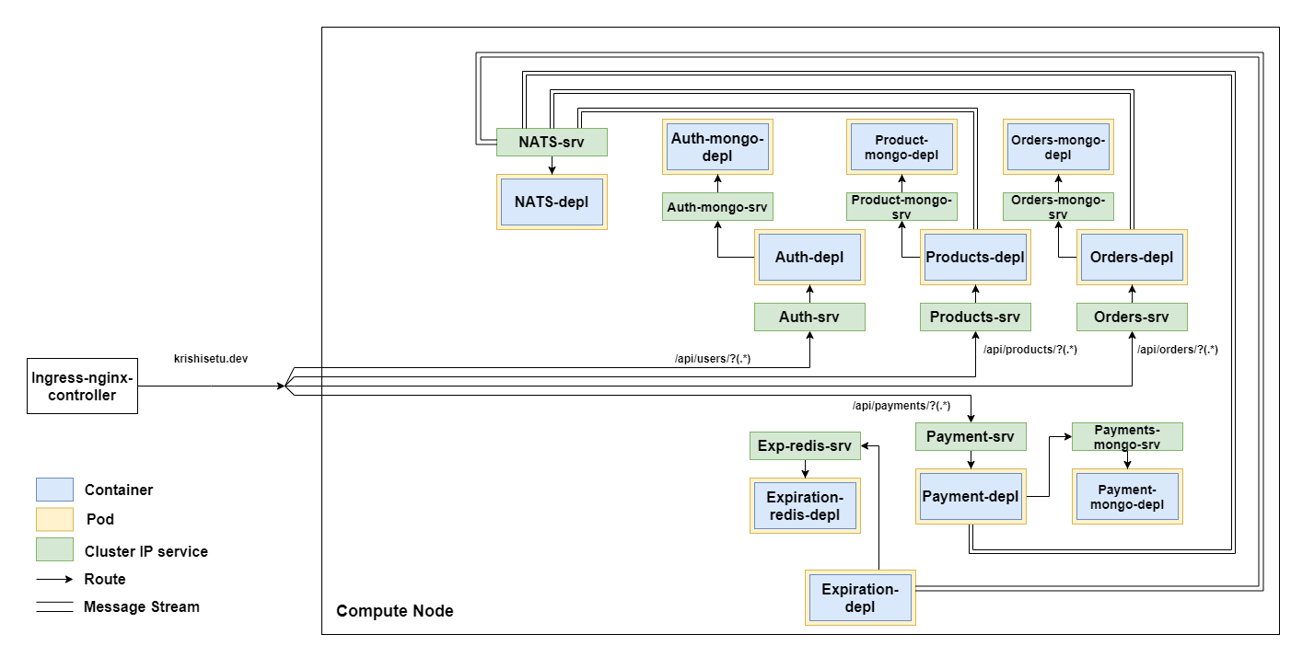
2.2 Design(Flow Of Modules)
Architecture of Krishisetu

Slide 16
2.3 Description Of Use Case
Krishisetu allows the farmers to register themselves and sell their goods online.
Krishisetu allows the consumers to register themselves and buy the available products.

Slide 17
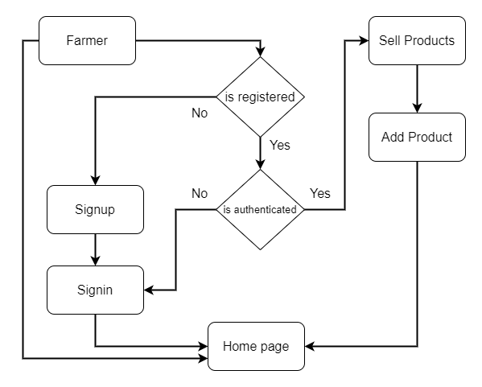
2.4 Activity Diagram
Farmer flow

Slide 18
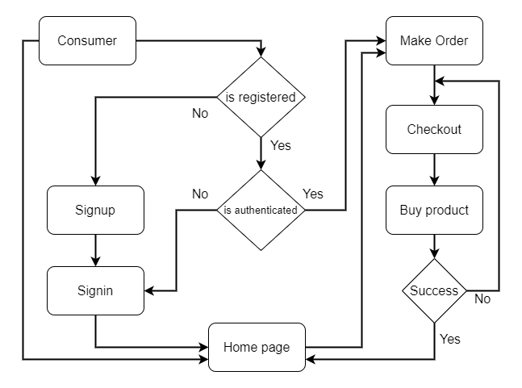
2.4 Activity Diagram
Consumer flow

Slide 19
2.5 Modules
Authentication and Authorization Strategies
Scalable Image Upload
Message Streaming
Code Sharing
Cross-Service Data Replication
Version Control

Slide 20
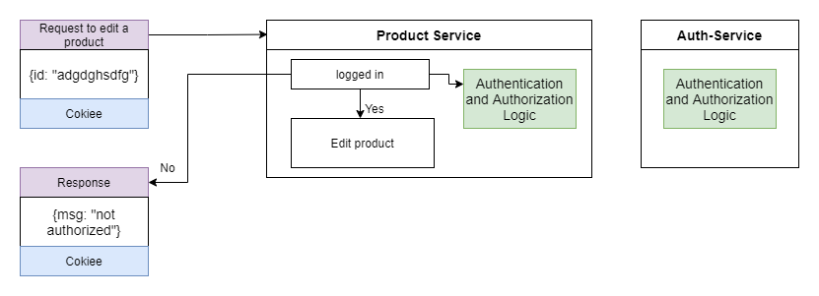
2.5 Module-1
Authentication and Authorization
Teaching microservices how to Authenticate a user

Slide 21
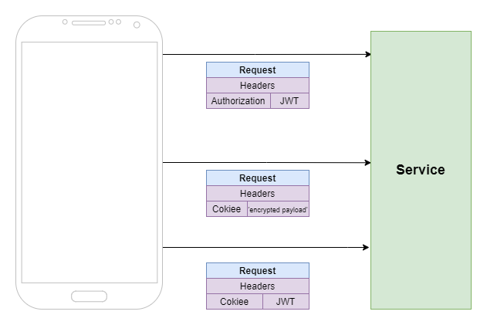
Authentication Mechanism

Slide 22
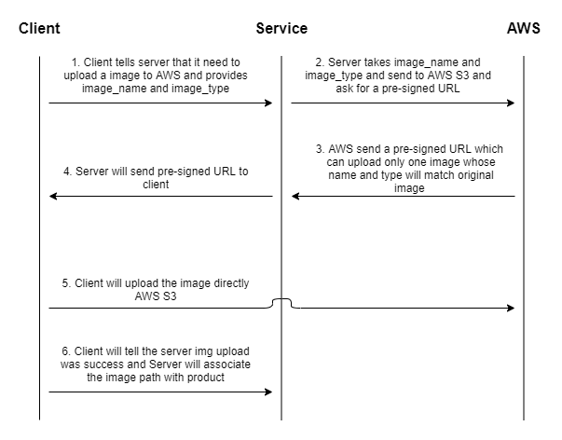
2.5 Module-2 : Scalable Image Upload
Working with Pre-signed URL flow

Slide 23
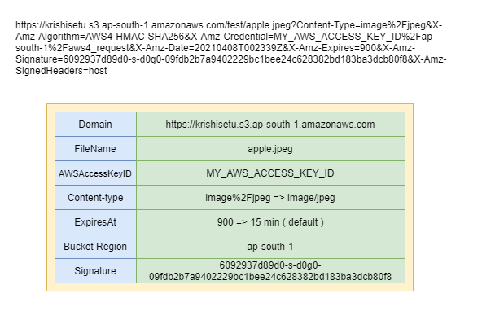
Example of pre-Signed URL

Slide 24
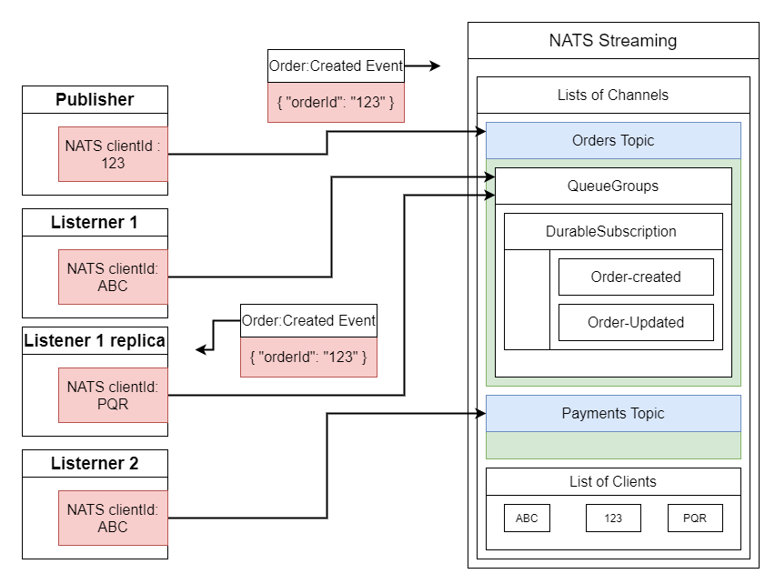
2.5 Module-3 : Message Streaming
NATS pub-sub architecture

Slide 25
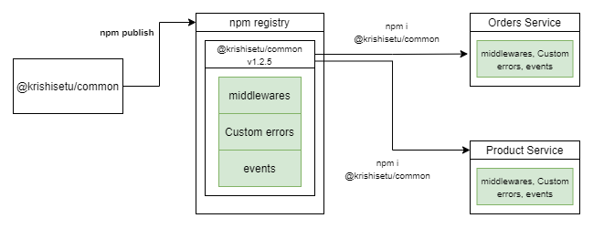
2.5 Module-4 : Code Sharing
@krishisetu/common npm module

Slide 26
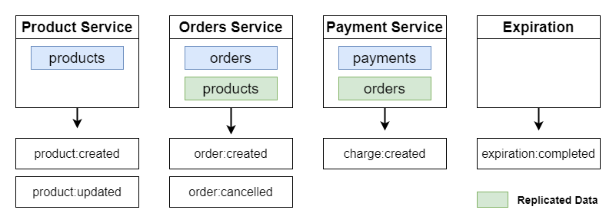
2.5 Module-5 : Cross-Service Data Replication
Cross-Service-Data-Replication

Slide 27
2.5 Module-6 : Version Control
Krishi Setu uses Github for version control. We are using Github Actions to automate testing. Automated tests get triggered every time we create a new pull request. After the testing is done we get the results of all the passed and failed test, if any test is a failing test we get a warning before we merge the code base with the master branch.

Slide 28
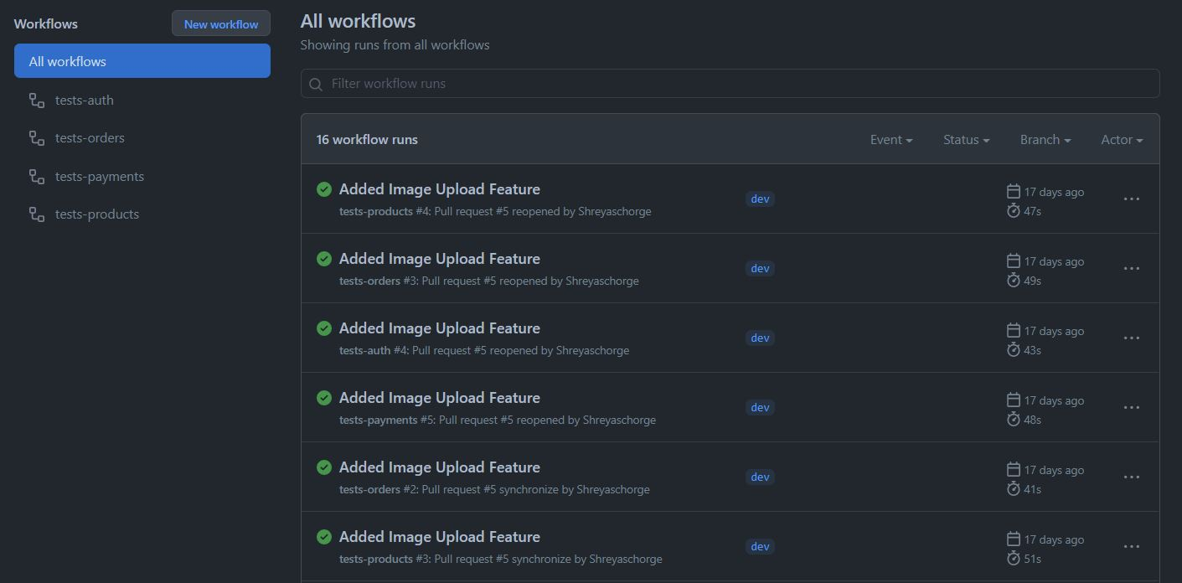
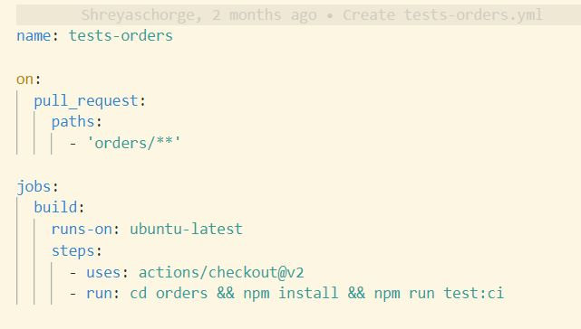
Automated test Suites

Slide 29
3. Conclusion and Future Scope

Slide 30
The main objective to build this application is to eliminate all the middlemen from the chain of distribution cycle by providing them with the platform on which they can sell their goods directly to the local distributors of major cities thus giving them the value for their goods.
Also making sure that the platform could maintain high traffic and scale up and scale down whenever necessary and it is always available to serve its users.
The entire application is leveraging Open Source technologies thus encouraging the developers community to contribute to the growth of the application and making it more reliable to its users.
For the future, we could add more services like a recommendation system, maps, comments, integrating monitoring system like Prometheus, Sharded Clusters and replica sets for reliability and high availability of the data.

Slide 31
References
[1] Leila Abdollahi Vayghan, Mohamed Aymen Saied, Maria Toeroe, Ferhat Khende, ”Kubernetes as an Availability Manager for Microservice Applications”, unpublished.
[2] L Magnon ”Modern Messaging for Distributed Systems”, Journal of Physics Conference Series 608(1):012038
[3] Poojya J Bhat, Priya D, ”Modern Messaging Queues - RabbitMQ, NATS and NATS Streaming”, International Journal of Recent Technology and Engineering (IJRTE)

Slide 32
Thank You

